Slide 1
Do one thing and do it well
CS 3335, Fall 2017
Dr. Zhiguang Xu

Slide 2
subjects
Procedural programming paradigm (Part I)
Small tools – efficient and flexible
Redirecting standard I/O
Linking small tools through pipes

Slide 3
Procedural programming
“Small is beautiful!”
Break down a programming task into a collection of small tasks and tackle with them one by one as
Self-contained programs/small tools
Data are accessed via standard I/O, redirection, and pipes
Data can also be made available through file, network (chapter 11), database, or other interfaces
This is the focus of this segment of the class.
Reusable functions (more later…)

Slide 4
An example: geo2json
We will build a program that displays route information on the Web map.
How the program should work? See page 108.
Version 1: geo2json_v1.c
Damn it! The input and output are all mixed up…

Slide 5
An example: geo2json (cont.)
How to make your program use files?
Version 1.1: still geo2json_v1.c, but redirect the stdin with < and the stdout with >
./geo2json_v1 < gpsdata.csv > output.json
Copy output.json into the folder map_files/, then load map.html in a browser.

Slide 6
An example: geo2json (cont.)
Version 2: geo2json_v2.c
File I/O
fopen(), fclose()
fprintf(), fputs()
fscanf(), fgets()
ftell(), fseek()
Note: in UNIX, there is no distinction between binary and text files, whereas in Windows, there are.

Slide 7
An example: geo2json (cont.)
What if there is some bad data in the GPS data file?
If input data can not pass the validating logic, the program quits with an error message and an error code.
Version 3: geo2json_v3.c
Regular output and error message are mixed up in the output file
Version 4: geo2json_v4.c
Separate stdout and stderr using fprintf()
If needed, stderr can be redirected to a file using 2> on the command line

Slide 8
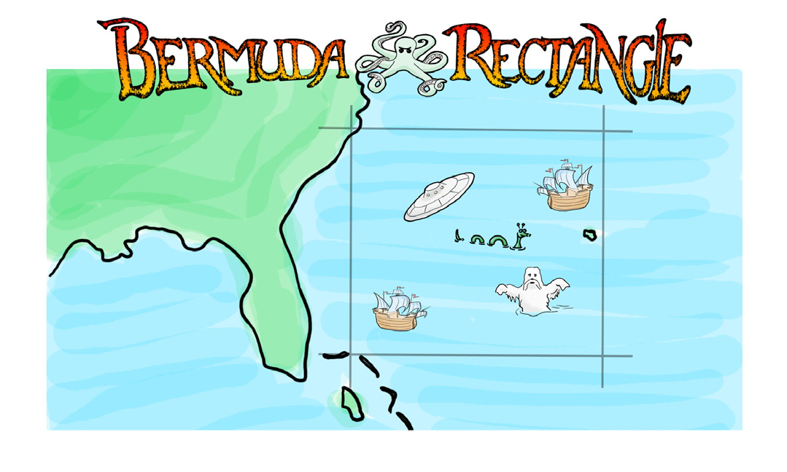
Another Example: Bermuda

Slide 9

Another Example: Bermuda (Cont.)
Keep geo2json as it is
Write a filter burmuda
Use a pipe to connect the stdout of burmuda (the filter) to the stdin of geo2json
bermuda
Download from the link on page 135
geo2json
(bermuda | geo2json_v1) < spooky.csv > output.json
Copy to map_files/

Slide 10
Output to multiple files
File I/O (see slide 6)
categorize_v1.c
categorize_v2.c
Add the following to the beginning of the code to display all the command-line arguments:
for(int i=0; i<argc; i++){
printf("argv[%d]=%s\n",i,argv[i]);
}
Obtain keyword and names of the three output files from the command-line arguments
categorize_v2 UFO aliens.csv Elvis elvises.csv the_rest.csv

Slide 11
Getopt()
Command-line options v.s. command-line arguments
Page 149
order_pizza.c

